Slide 1
-:WBC Multiclass Classification :- -: Project Finale :-
Done and Submitted by :
Girish Tripathy
Shashank Saumya
Instructor:
Dr. Subhankar Mishra

Slide 2
What we had achieved
We had a simple working CNN model.
The model was overfitting.
Training after data augmentation was not possible on our devices.

Slide 3
What we did
Shifted to Google Co-lab
Image Segmentation
Trying Different models and hyperparameters

Slide 4
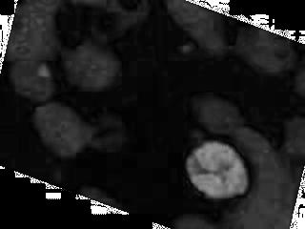

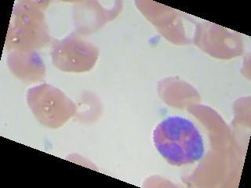
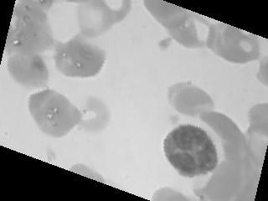
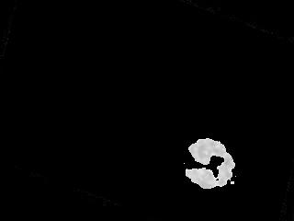
Nucleus Segmentation
HSV
Saturation
Otsu
Threshold
RGB Image
Grayscale
Combined Image

Slide 5
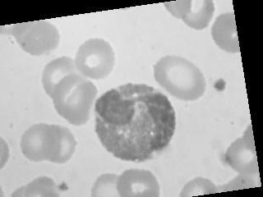
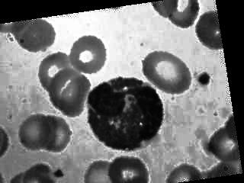
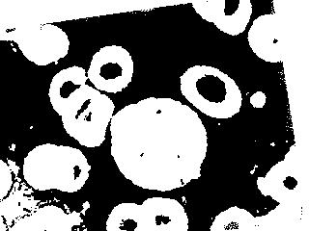
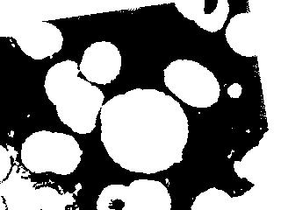
Cell Segmentation
Original
AHE
Otsu Threshold
Erosion

Slide 6
Image Segmentation
Not the best technique out there.
Works well for the colour scheme in our dataset.
There are some images which do not work well with my nucleus segmentation technique.
Unable to completely remove all other cell holes in cell segmentation

Slide 7
Trying different models and their results

Slide 8
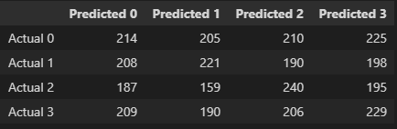
Model 1 (Base model): Simple CNN 2 Conv2D layer + 2 Dense Layer + Adam optimiser + One-hot-encoding + 30 epochs Training acc = 99.97%, Testing acc = 27.51%

Slide 9
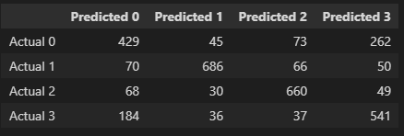
Model 2: Model 1 + image segmentation using otsu thresholding
Training acc = 98 % , Testing accuracy = 70%

Slide 10
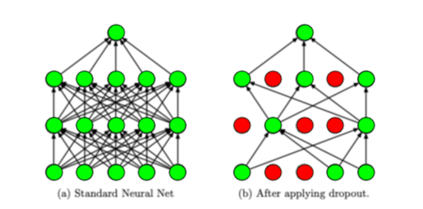
Regularisation :
Dropout Regularisation:

Slide 11
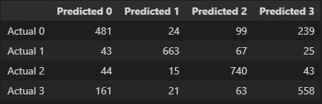
Model 3: Model 2 + Dropout Regularisation (0.78)
Training Acc : 83% , Testing acc : 74%

Slide 12

Model 4 : Using Better image segmentation (Otsu 2.0)
Training Accuracy : 98.74%
Testing Accuracy : 72%

Slide 13

Model 5 : Model 4 + Dropout layer (Present best working model) Training Acc : 89.67 % Testing Acc : 77.94 %

Slide 14
Problems we see and possible fixes
Possible problematic areas 1 : No Image Augmentation
2 : Still not clear image , needs to be cropped
3 : Model Getting confused in Class 1 (Eosinophil) and class 4 (Nutrophil). Maybe due to similar structure of nucleus.

Slide 15
Our 5 Mins…
Will try to train the model with image augmentation
How?
Our augmented dataset is large hence Out of memory errors.
Will train model in phases.
(25% training in first phase then save the model to retrain on another batch and so on… )

Slide 16
References
Information on NN:-
Basic NN:- Course on coursera by Andrew Ng
CNN:- Ming Li (MIT, waterloo) lectures on Deep Learning and google
Research Papers:-
M. Sharma, A. Bhave, R.R. Janghel, White Blood Classification using Convoluted Neural Networks, Springer 2019
S. Manik, L.M. Saini, N.Vadera, Counting and classification of white blood cell using Artificial Neural Network (ANN), in IEEE International Conference on Power Electronics, Intelligent Control and Energy Systems (ICPEICES), IEEE (2016)

Slide 17
Thank You

